Slide 1

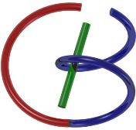
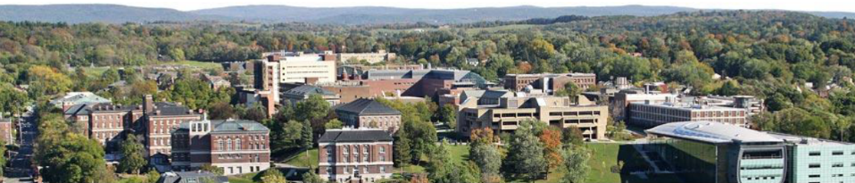
38655 BMED-2300-02
Lecture 21: Ultrasound Principle
Ge Wang, PhD
Biomedical Imaging Center
CBIS/BME, RPI
wangg6@rpi.edu
April 13, 2018

Slide 2
BB Schedule for S18
Tue | Topic | Fri | Topic
1/16 | Introduction | 1/19 | MatLab I (Basics)
1/23 | System | 1/26 | Convolution
1/30 | Fourier Series | 2/02 | Fourier Transform
2/06 | Signal Processing | 2/09 | Discrete FT & FFT
2/13 | MatLab II (Homework) | 2/16 | Network
2/20 | No Class | 2/23 | Exam I
2/27 | Quality & Performance | 3/02 | X-ray & Radiography
3/06 | CT Reconstruction | 3/09 | CT Scanner
3/20 | MatLab III (CT) | 3/23 | Nuclear Physics
3/27 | PET & SPECT | 3/30 | MRI I
4/03 | Exam II | 4/06 | MRI II
4/10 | MRI III | 4/13 | Ultrasound I
4/17 | Ultrasound II | 4/20 | Optical Imaging
4/24 | Machine Learning | 4/27 | Exam III
Office Hour: Ge Tue & Fri 3-4 @ CBIS 3209 | wangg6@rpi.edu
Kathleen Mon 4-5 & Thurs 4-5 @ JEC 7045 | chens18@rpi.edu

Slide 3
Ultrasound Imaging Principle
Ultrasound Wave
Wave Equation
Acoustic Impedance
Sound-tissue Interaction
US Transducer
Single Unit & Array
Image Resolution
Micro-bubbles

Slide 4
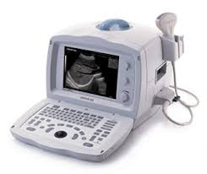
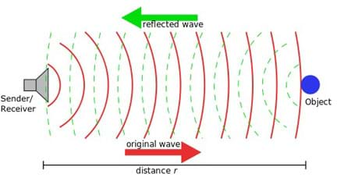
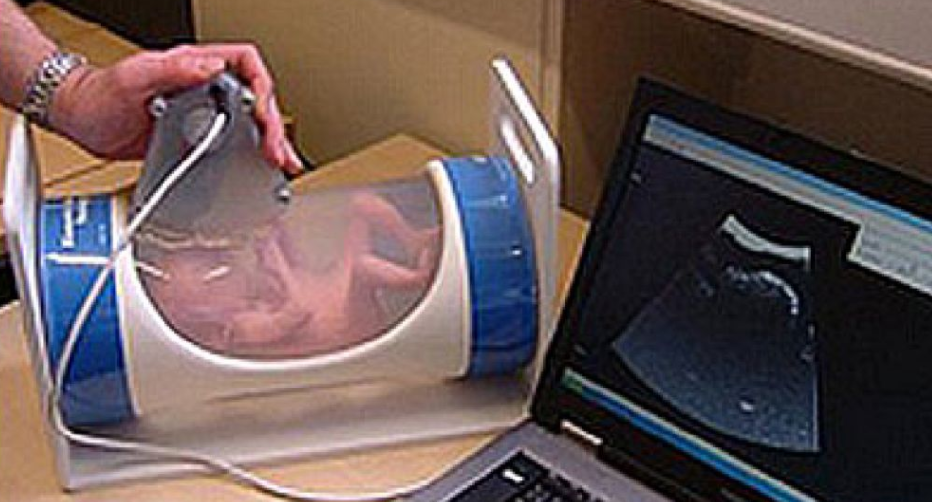
Ultrasound Imaging
Measure interactions between biological soft tissues and ultrasound waves
No Ionizing Radiation
High Imaging Speed
Low System Cost
Limited Penetration Depth
Strong Artifacts
Pediatric Imaging, Cardiac Studies, Image-guided Procedures, Neurological Stimulation…

Slide 5
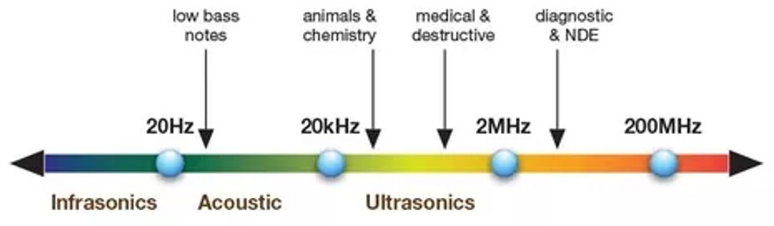
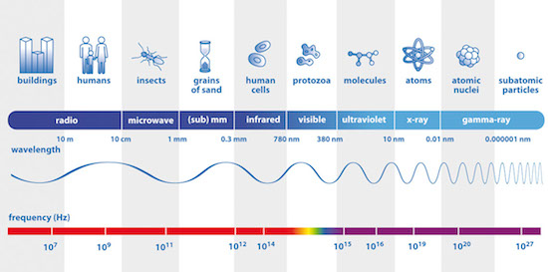
US Range

Slide 6
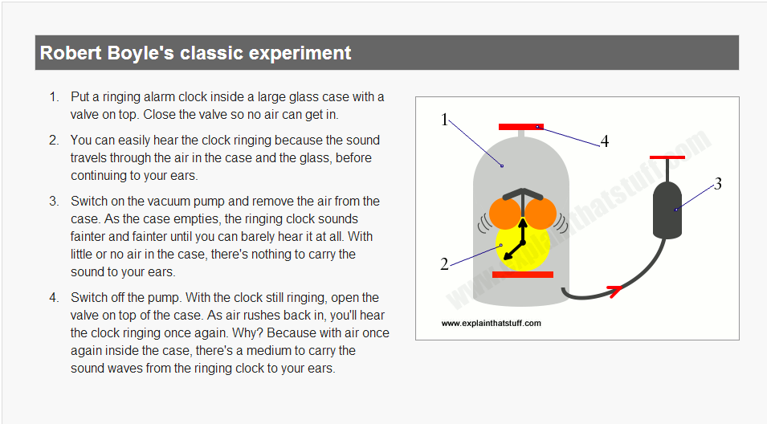
http://www.explainthatstuff.com/sound.html

Slide 7
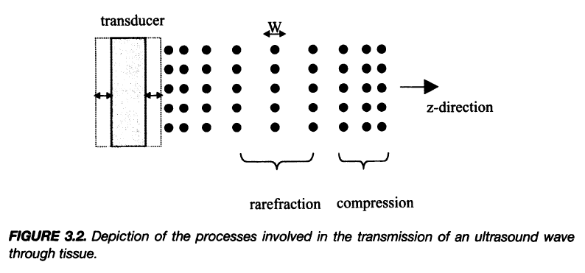
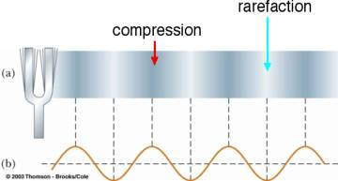
Ultrasound (US) Wave

Slide 8
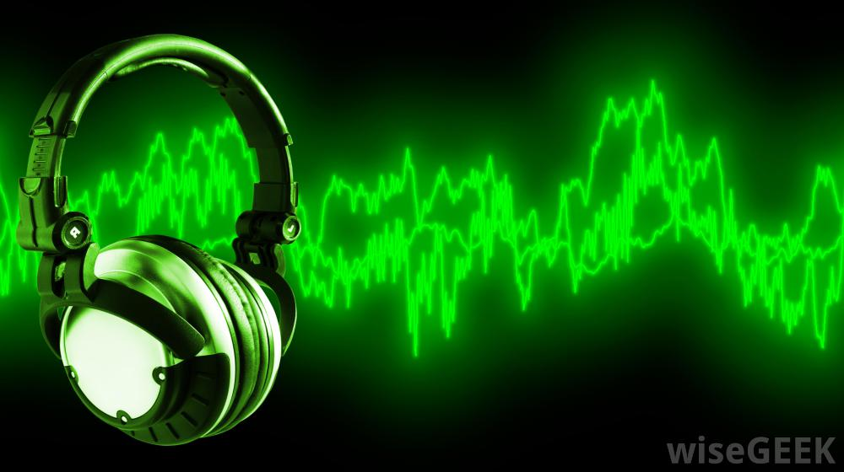

How to Form Wave?
Conservation of Mass
Relationship between Pressure & Volume
Newton’s 2nd Law

Slide 9
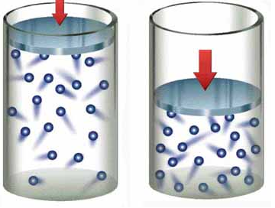
How to Form US Wave?
a (acceleration) +
u (velocity) +
w (displacement) +
w (displacement) +
V (volume) –
p (pressure) +

Slide 10
How to Form US Wave?
w = ½*a*t²
a (acceleration) +
u (velocity) +
w (displacement) +
w = u*t
w (displacement) +
V (volume) –
p (pressure) +

Slide 11
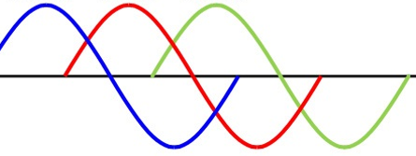
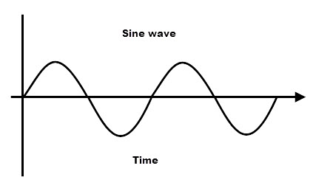
How to Form Wave?
a (acceleration) +
u (velocity) +
w (displacement) +
w (displacement) +
V (volume) –
p (pressure) +

Slide 12
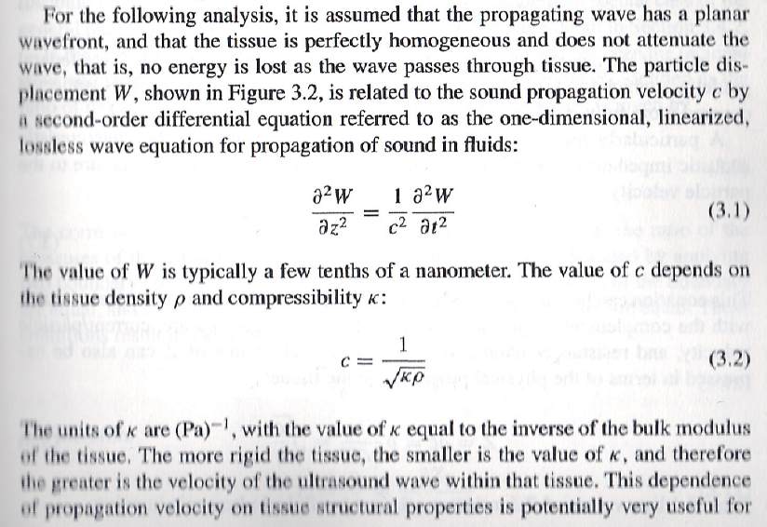
Wave Equation

Slide 13
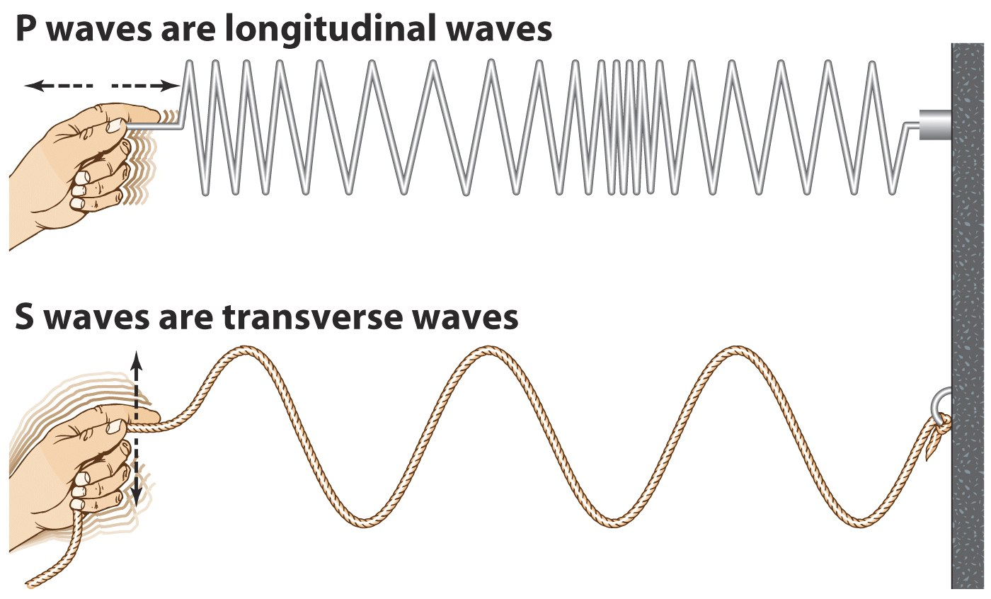
P & S Waves

Slide 14
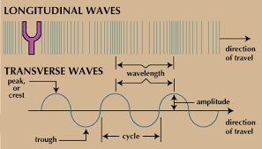
P & S Waves

Slide 15
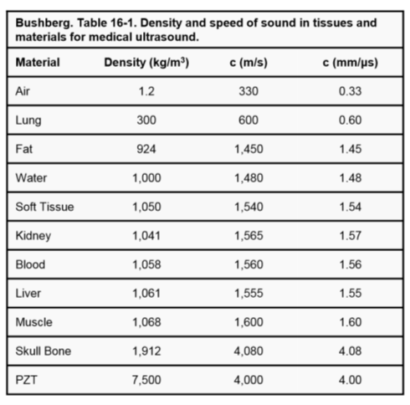
Speed of Sound
In the Same Medium:
Higher Frequency,
Shorter Wavelength

Slide 16
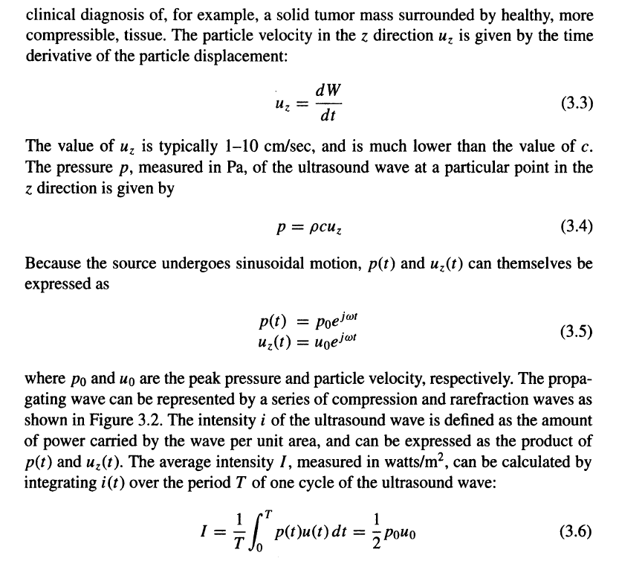
Velocity, Pressure, & Intensity

Slide 17
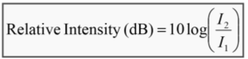
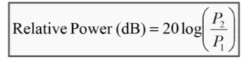
Ultrasound Imaging
Characteristics of Sound
Pressure intensity is expressed in dB scale in US
Pressure (P) [Pascal(Pa)] (1Pa = 1 Newton/m² ; [N] =[kg.m/s⁻²])
Atmosphere: P=0.1MPa
Diagnostic US: P=1MPa
Relative intensity and power are described in decibels (dB)
In diagnostic US, the incident pulse can be up to 1 million times more than the echo pulse
The log function “compresses” the large scale ratios and “expands” the small ratios in to more manageable range
A change in 10dB → one order magnitude (10x) change in intensity
A change of 20dB → two order magnitude (100x) change in intensity

Slide 18
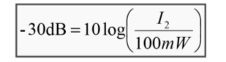
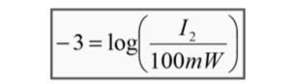
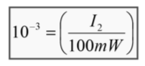
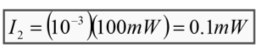
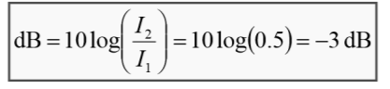
Ultrasound Imaging
Characteristics of Sound
Review Question: Calculate the remaining intensity of a 100mW US pulse that loses 30dB while traveling through tissue
Review Question: Find the “half-value” thickness for ultrasound. The half-value thickness indicate the intensity is decreased by 50%

Slide 19
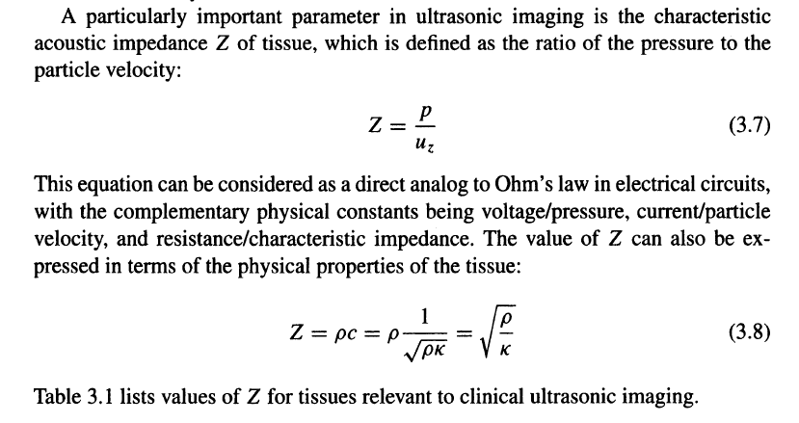
Acoustic Impedance

Slide 20
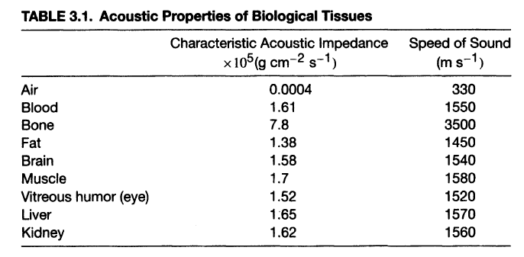
Tissue Acoustic Properties

Slide 21
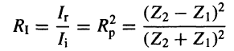
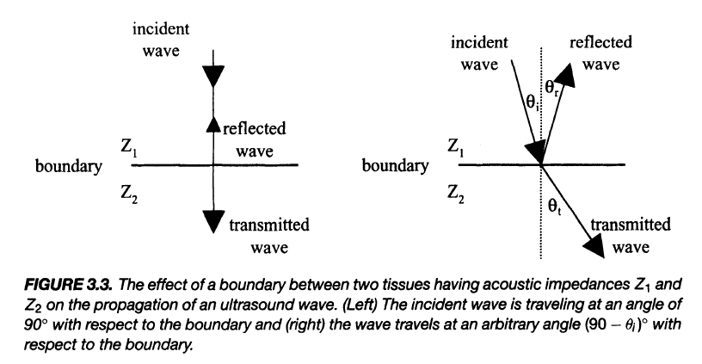
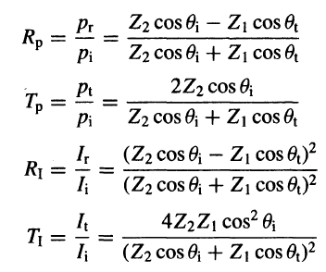
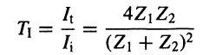
US-Tissue Interaction
Reflection – At tissue boundary
Refraction – Change in direction
Scattering – Energy diffusion
Absorption – Energy into heat
Attenuation – Intensity decay due to absorption & scattering

Slide 22
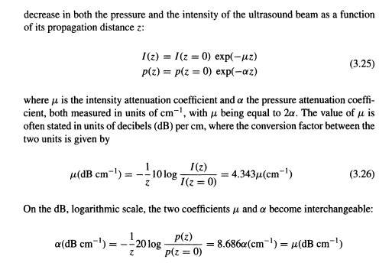
Again, Exponential Decay
$α\left(f\right)=af^{b}$ High-frequency → Larger µ / Less Penetration

Slide 23
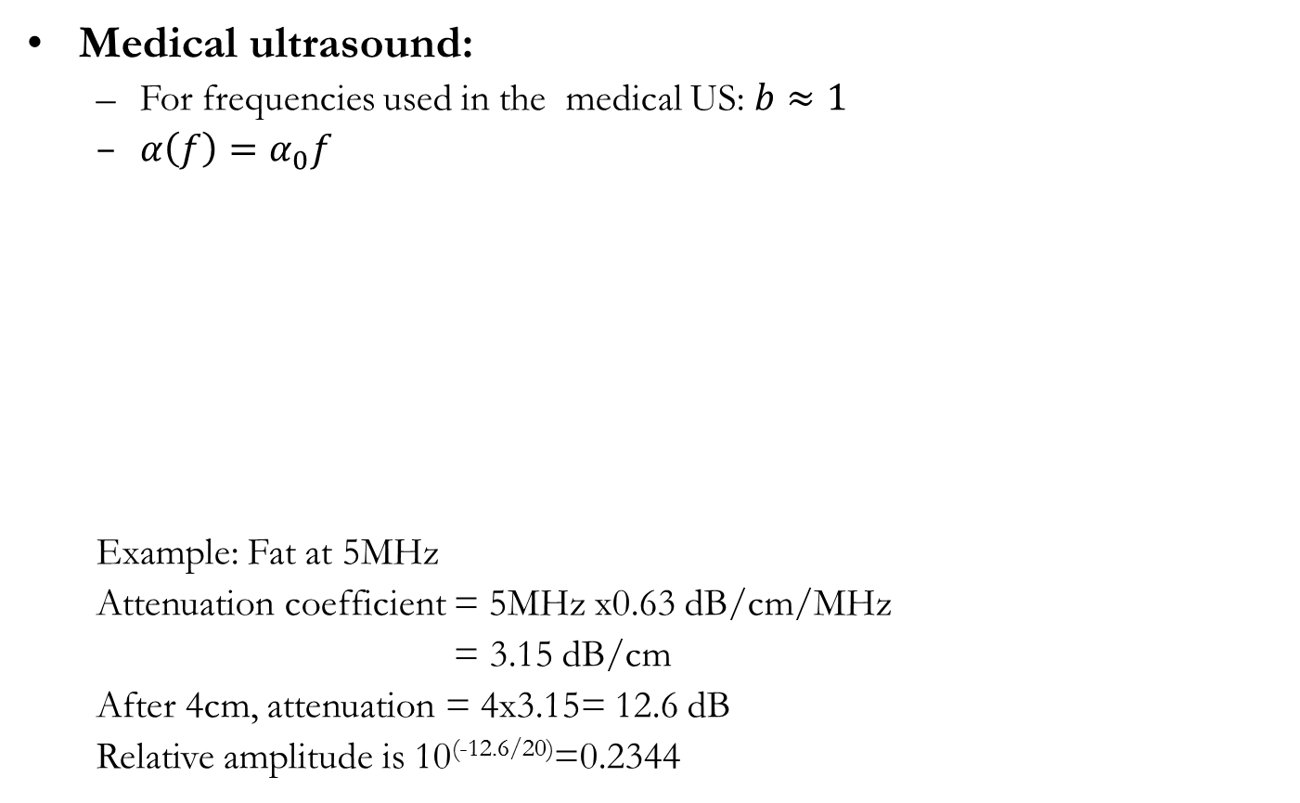
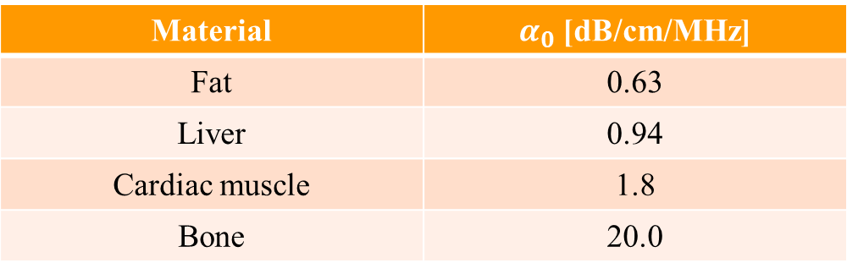
Ultrasound Imaging
Medical ultrasound:
For frequencies used in the medical US: $b≈1$
$α\left(f\right)=α_{0}f$
Example: Fat at 5MHz
Attenuation coefficient = 5MHz x0.63 dB/cm/MHz
= 3.15 dB/cm
After 4cm, attenuation = 4x3.15= 12.6 dB
Relative amplitude is 10^{(-12.6/20)}=0.2344
Material | $α_{0}$ [dB/cm/MHz]
Fat | 0.63
Liver | 0.94
Cardiac muscle | 1.8
Bone | 20.0

Slide 24
Ultrasound Imaging
Reflection coefficients – implications
No ultrasound images of brain in vivo; skull reflects ultrasound.
Images of the heart have to be taken “round” the ribs, which are also opaque.
Finding the right “window” into the body is important.
The ultrasound transducer must be “coupled” to the body using a special gel.
The material from which transducers are made has a very different acoustic impedance Z_{transducer} to that of the body Z_{tissue} and more importantly that of air Z_{air}.
Little of the signal gets through at a transducer-tissue boundary (p_{r}/p_{i} ≈-.86) and virtually none at a transducer-air boundary p_{t}/p_{i} ≈-0.9997).

Slide 25
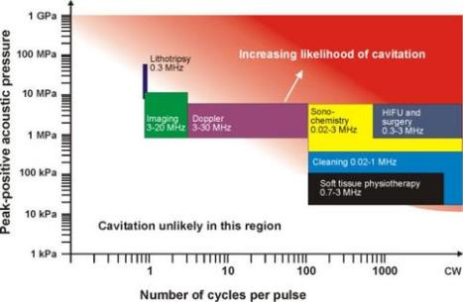
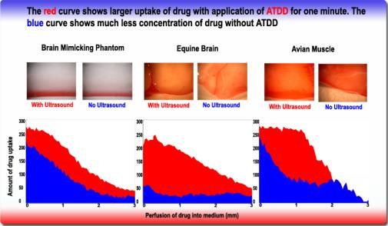
Ultrasound Imaging
Thermal Effects:
Increased collagen tissue extensibility
Increased blood flow
Increased nerve conduction Velocity
Increased pain threshold
Increased enzymatic activity
Decreased muscle spasm
Non-thermal Effects
Increased cell membrane permeability
Increased vascular permeability
Increased blood flow
Reduction of edema
Cavitation
Acoustical streaming

Slide 26
Ultrasound Imaging Principle
Ultrasound Wave
Wave Equation
Acoustic Impedance
Sound-tissue Interaction
US Scanner
Single Unit & Array
Image Resolution
Micro-bubbles

Slide 27
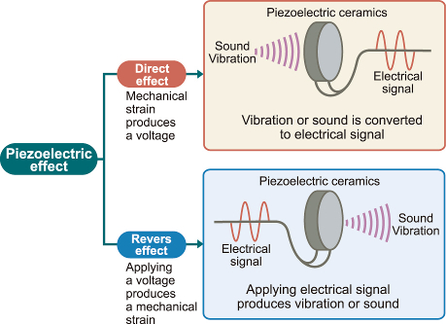
How? – Piezoelectric Effect

Slide 28
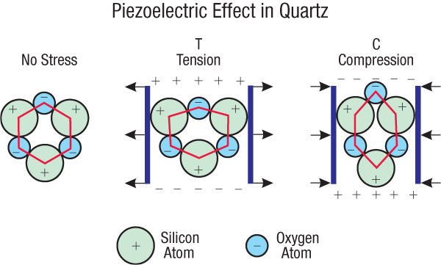
Why? – Static Electric Balance

Slide 29
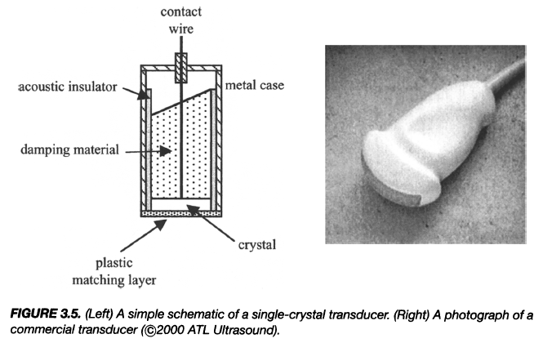
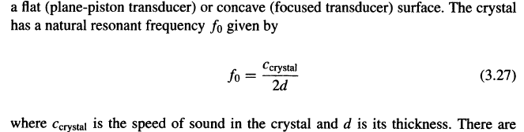
Single-Crystal Transducer

Slide 30
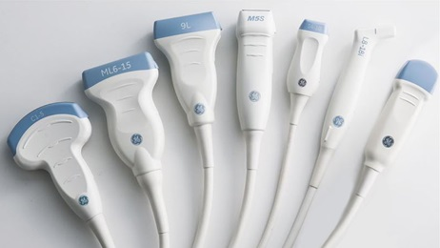
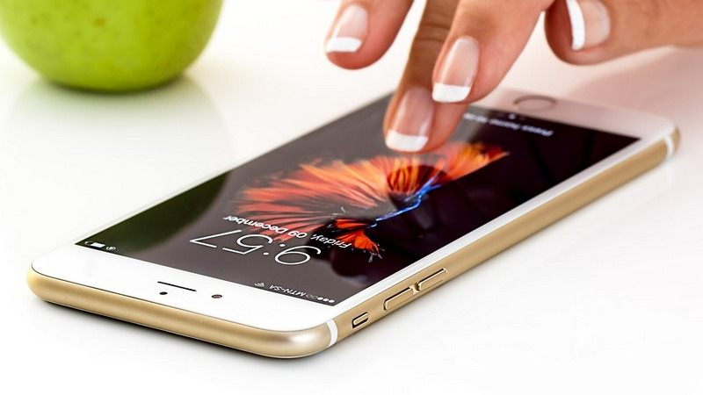
US Probes

Slide 31
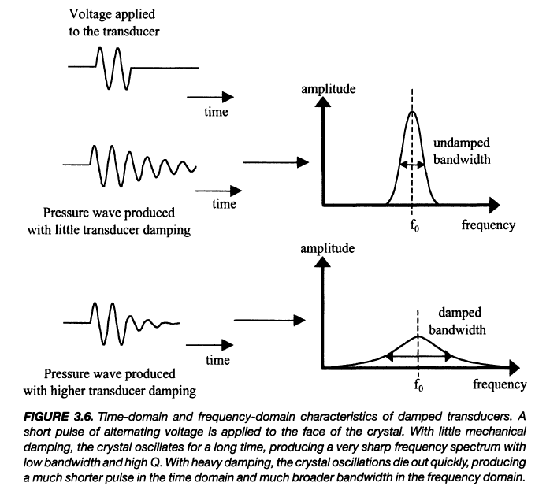
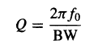
Transducer Damping

Slide 32
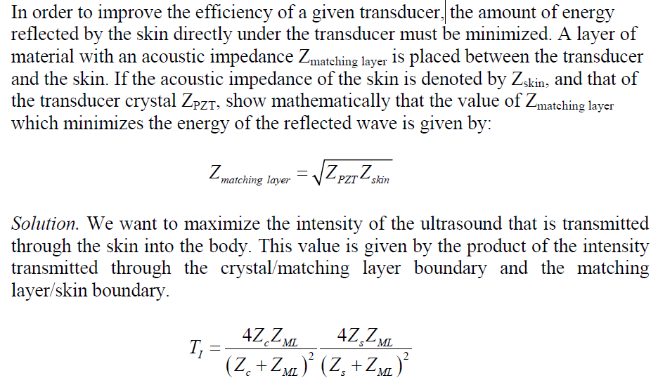
Matching Layer

Slide 33
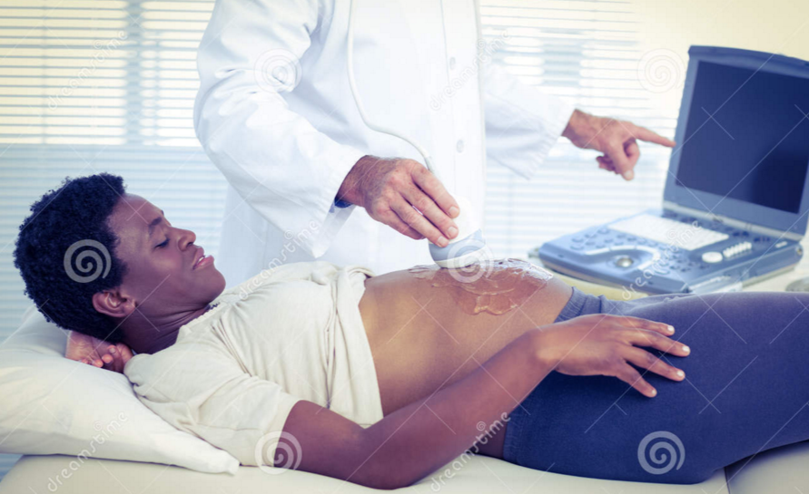
Ultrasound Gel

Slide 34
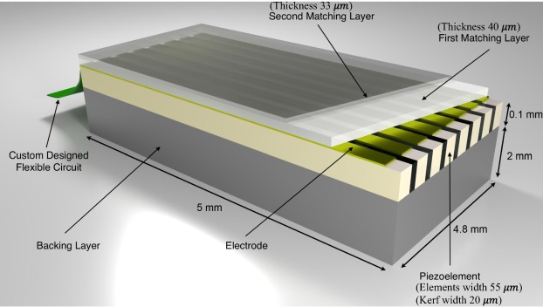
US Transducer Array

Slide 35
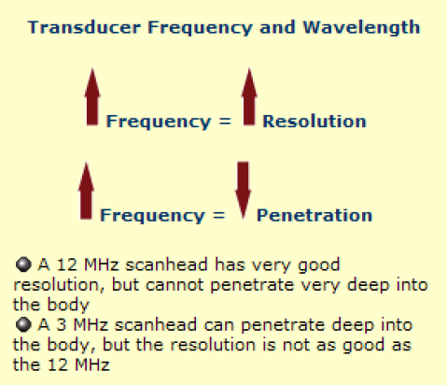
Resolution vs Penetration

Slide 36
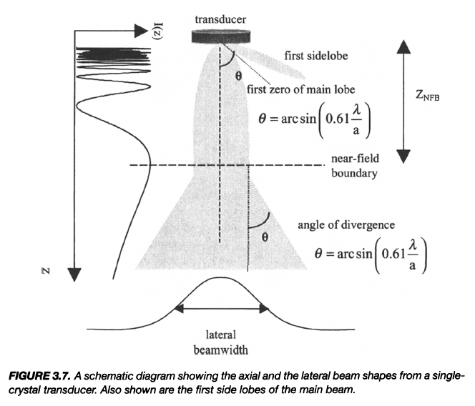

Beam Geometry

Slide 37

Lateral Resolution

Slide 38


US Focusing

Slide 39


Axial Resolution

Slide 40

Image Contrast
Acoustic waves interact various tissues differently
Hyperechoic – Higher scatter amplitude than average
Hypoechoic – Lower scatter amplitude than average

Slide 41

Microbubble as Contrast Agent

Slide 42

Acoustically Enabled Drug Delivery

Slide 43

Homework for US I
Due Date: Same (1 Working Week Later)

